Slide 1



RESUME SHORTLISTING
System
Aryan Khunt (56)
Aditiya Kumar Pandey (29)
Geetika (42)

Slide 2


TABLE OF
Contents
01
Introduction
02
Literature Survey
03
Problem Statement
04
Database Description
05
05
Software and Hardware components
6
Result Screenshot

Slide 3

Introduction
In today’s competitive job market, both HR teams and job seekers face significant challenges in the recruitment process.
HR professionals often spend countless hours manually reviewing resumes.
Job seekers frequently struggle to receive immediate feedback on their eligibility for roles.
Our AI Resume Screening Tool is designed to solve these problems.
It leverages the power of Artificial Intelligence (AI), Natural Language Processing (NLP), and Machine Learning (ML).
The tool automates the resume screening process, saving time and effort for HR teams.
It instantly matches candidates to relevant job roles based on the content of their resumes.
Page 01 of 07

Slide 4

LITERATURE
This tool streamlines the hiring process for HR teams by automating resume screening.
It also empowers job seekers by providing immediate feedback on their qualifications.
As a result, it helps both HR teams and candidates connect more efficiently and effectively.
In this presentation, we will cover:
How the tool works
Its key features
The benefits it offers to both HR professionals and job seekers
Survey
CVViZ: An AI-powered tool that contextually screens resumes, automating candidate sourcing and matching the right candidates to the right jobs.
Freshteam: Extracts complex data from resumes to create enriched candidate profiles, streamlining the hiring process.
Trakstar Hire: Offers automated resume parsing and candidate ranking to help recruiters identify top talent efficiently.
EXISTING PLATFORMS
Page 02 of 07

Slide 5

PROBLEM STATEMENT
Recruiting talent is challenging and time-consuming for HR teams.
HR professionals spend excessive time manually reviewing large volumes of resumes.
This manual process makes it difficult to identify the best candidates quickly.
It is also inefficient and prone to human bias and error.
Job seekers often face delays in receiving timely feedback on their resumes.
This leads to uncertainty about job eligibility and missed opportunities.
The lack of automation in the recruitment process causes delayed decisions and overall inefficiencies for both recruiters and candidates.
Page 03 of 07

Slide 6
TECH COMPONENTS
Programming Languages:
Python – For building the machine learning models, integrating the UI, and backend processing.
Frameworks & Libraries:
Streamlit – For developing the web interface.
Scikit-learn – For implementing machine learning algorithms.
NLTK / SpaCy – For natural language processing (NLP) and text preprocessing.
Pandas & NumPy – For handling and processing resume data.
Database Management:
MySQL – For storing shortlisted candidate details.
Machine Learning Model:
Random Forest (RF.joblib) – The trained model used for classifying resumes.
Development Tools:
VS Code – For writing and debugging Python scripts.
Git & GitHub – For version control.
Page 06 of 07

Slide 7
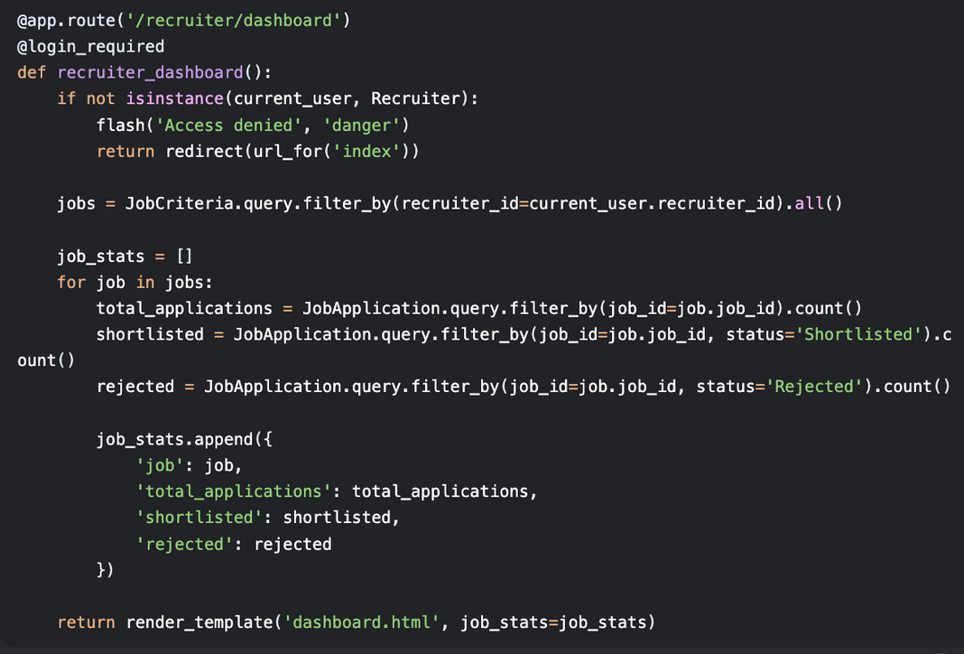
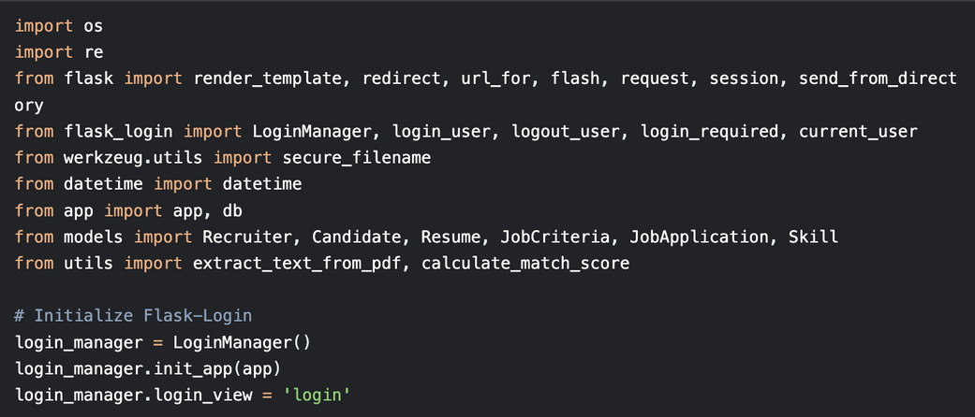
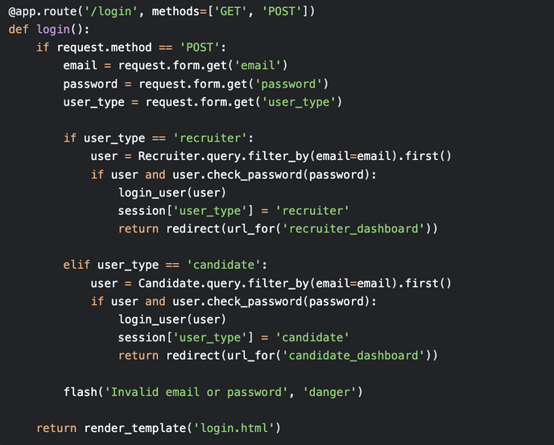
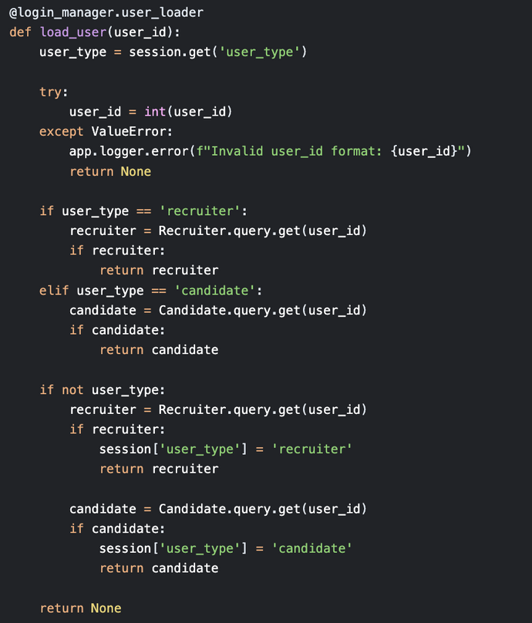
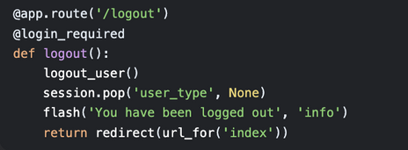
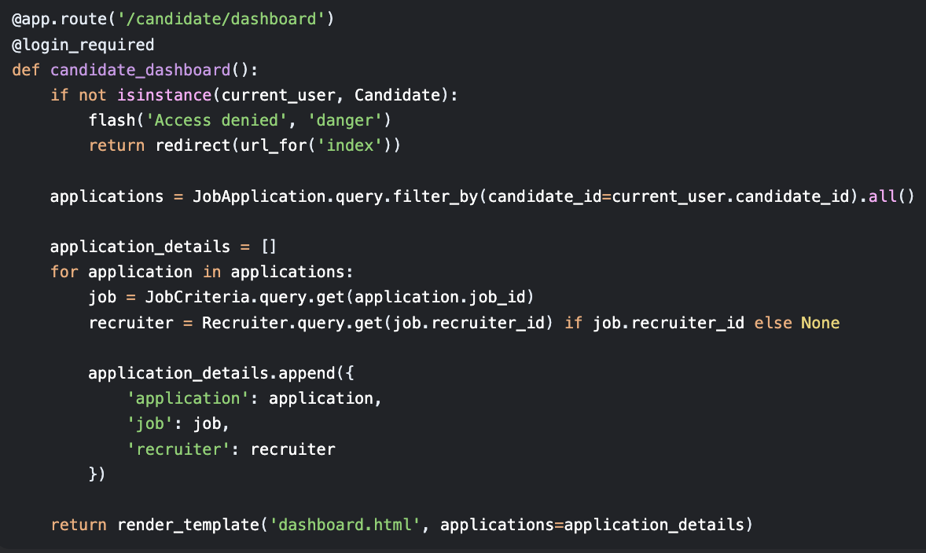
SAMPLE CODE
Page 07 of 07

Slide 8
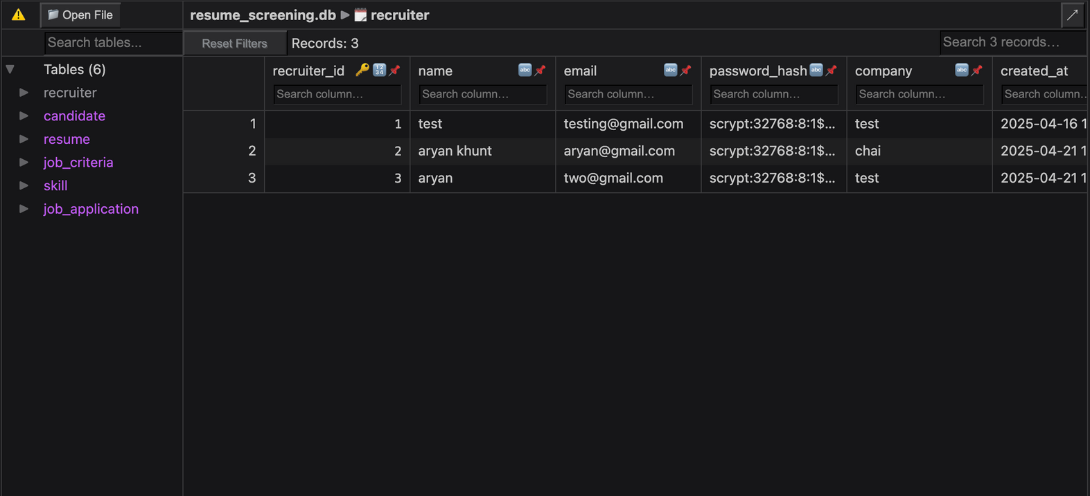
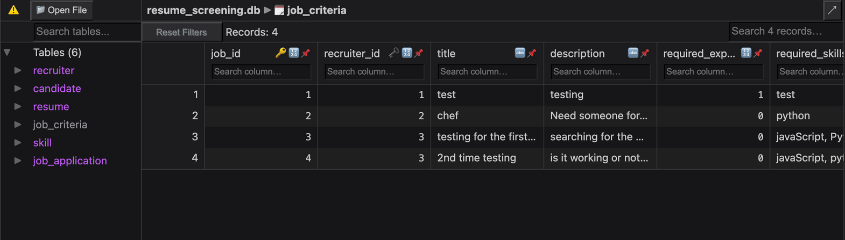
DATABSE
SQL LITE
Page 07 of 07

Slide 9
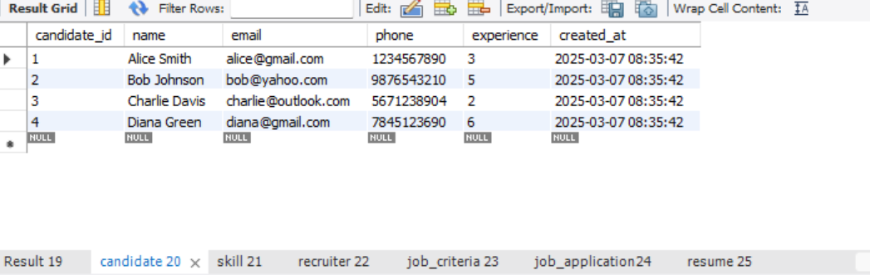
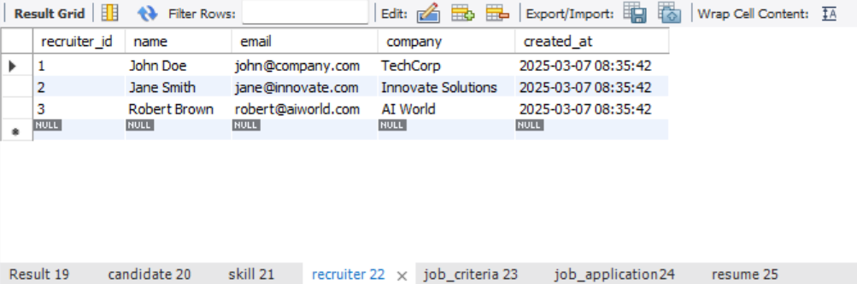
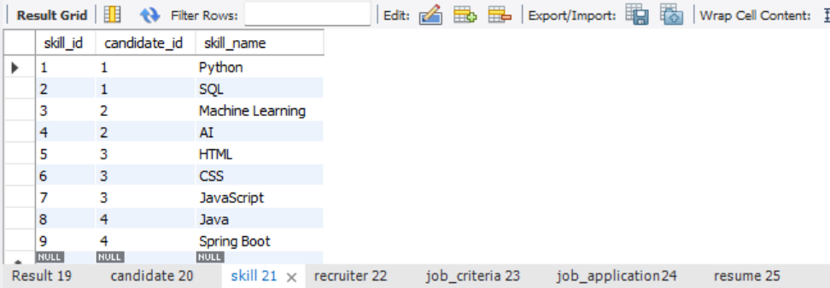
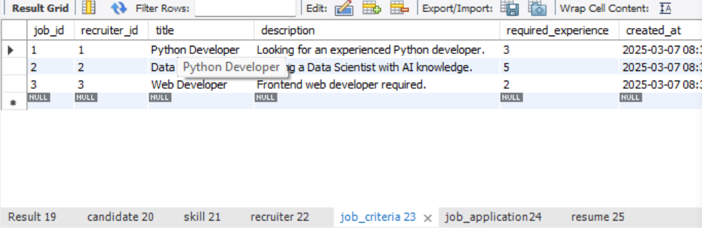
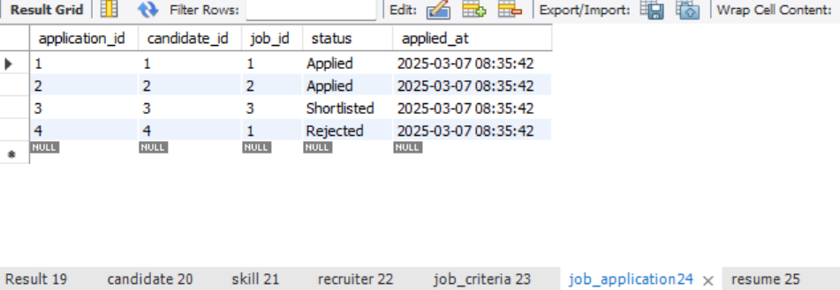
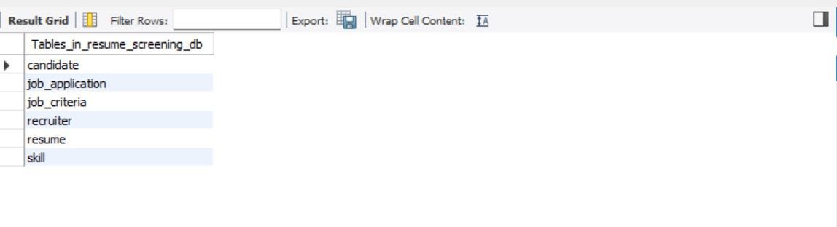
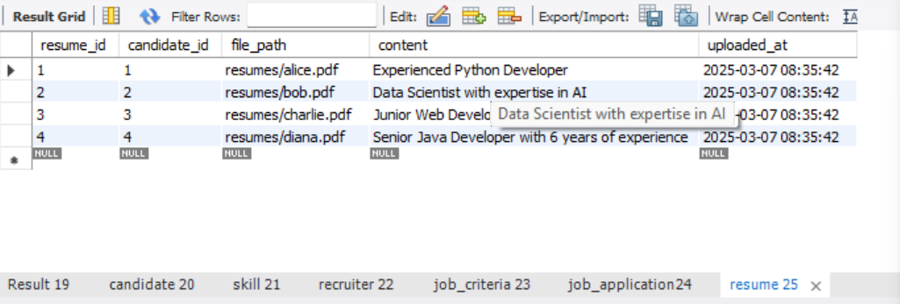
RESULTANT
TABLES
Page 07 of 07

Slide 10
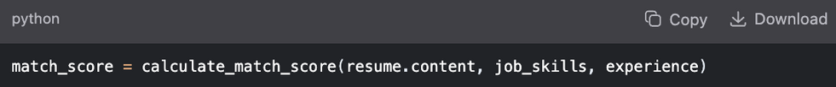

APPLICATIONS
Automated Resume Screening
Smart Matching Algorithm
Bias-Free Shortlisting
Real-Time Analytics Dashboard
Skill Gap Analysis
O
f using it!!
HOW IT
OPERATES!!!!
"Reduces hiring time by 60%" / "Improves candidate fit by 40%".
Annotate your dashboard image to show scorecards and analytics.
Visual flow: Upload Resume → Parse Data → Match Score → Dashboard.
Page 02 of 07

Slide 11

THANK
You

